Slide 1
19- Volume Rendering
Dr. Hamish Carr & Dr. Rafael Kuffner dos Anjos

Slide 2
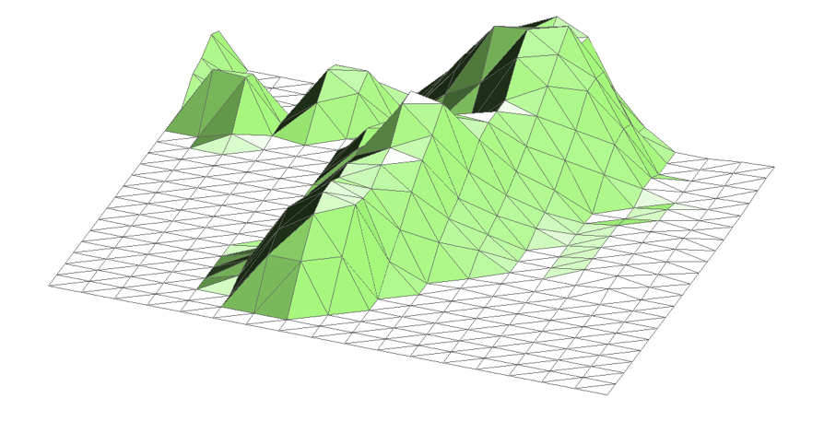
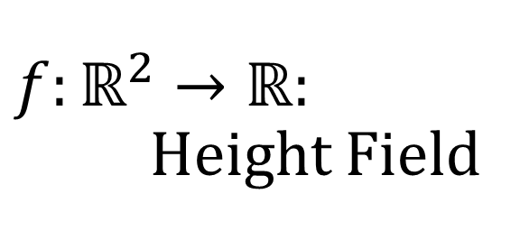
$f:ℝ^{2}→ℝ$: Height Field
For every point in the plane, define a height
The graph is then a terrain
i.e. a surface in a 3D embedding space

Slide 3
Contours
We can define curves using contours
Let an artist design the landscape
Pick a threshold, generate a curve

Slide 4
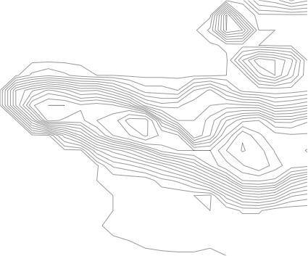
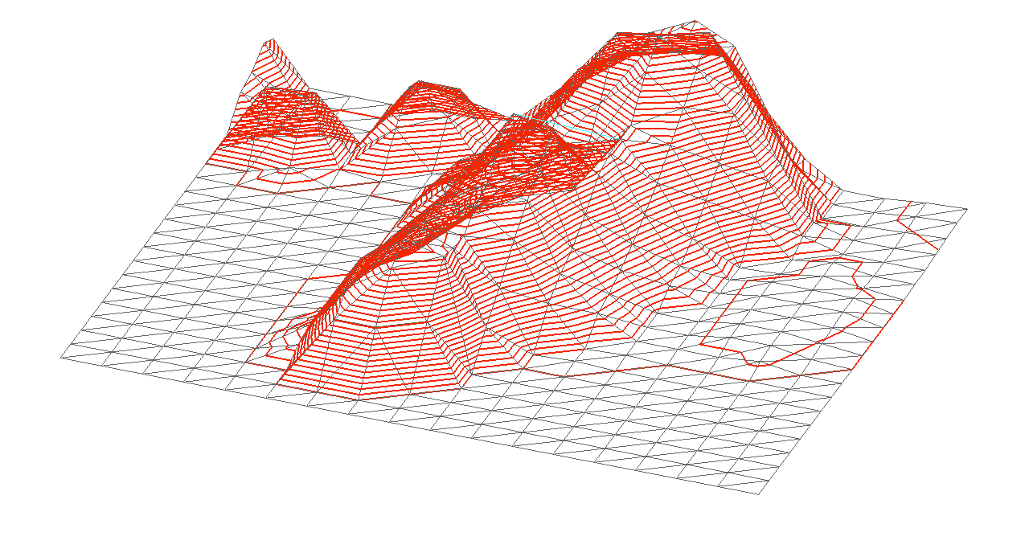
Manifold Dimension
f is a 2-manifold embedded in 3-D
It's contours are 1-manifolds
embedded in 2-D
or in 3-D
What happens if we add a dimension?

Slide 5
Implicit (Blobby) Surfaces
Define a function $f:ℝ^{3}→ℝ$
Often a sum of Gaussian distributions
It's a 3-manifold embedded in 4-D
It's contours are 2-manifolds in 3-/4-D
Choose a threshold h
Extract the level set / contours
They are guaranteed to be manifold

Slide 6
Implicit Surfaces
We can use many types of functions:
CT/MRI scans
Numerical simulations
Mathematical models – eg. sum of Gaussians
Distance fields
any property we can compute in 3-D
In practice, we need to start with a 3-D mesh

Slide 7
Meshes in 3D
In 2-D, we used triangles and squares
In 3-D, we use tetrahedra and cubes
also pyramids, octahedra & triangular prisms
Interpolation follows the same rules as in 2-D
geometric interpolation (meshes)
kernel filters (sampling theory)

Slide 8
Simplices
An n-simplex is the simplest n-dimensional object
a cell defined by n+1 points
0-simplex: 1 point
1-simplex: line segment - 2 points
2-simplex: triangle - 3 line segments, 3 points
3-simplex: tetrahedron - 4 triangles, 6 line segments, 4 points

Slide 9

Simplicial Complex
A simplicial complex or simplicial mesh is a set of simplices
usually uses barycentric interpolation
can use Bézier interpolation

Slide 10
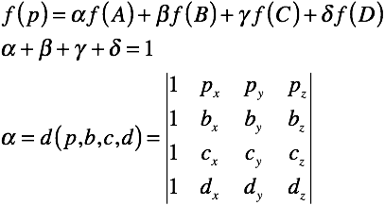
Barycentric Interpolation
Linear interpolation based on distances
Extend by using distance to faces

Slide 11
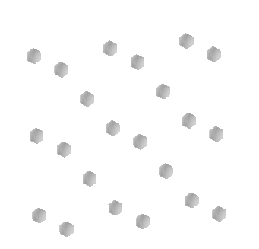
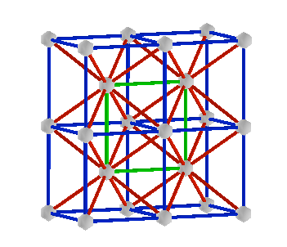
Simplex Construction
By hand (owch!)
Delaunay triangulation (later)
Subdividing Cubes
Subdividing Meshes

Slide 12
Isosurfaces
Contours in 3D
Basically the same as we saw in 2D
2-manifolds embedded in 3 or 4 space
But we can’t usually show multiples
because we’ve run out of dimensions

Slide 13
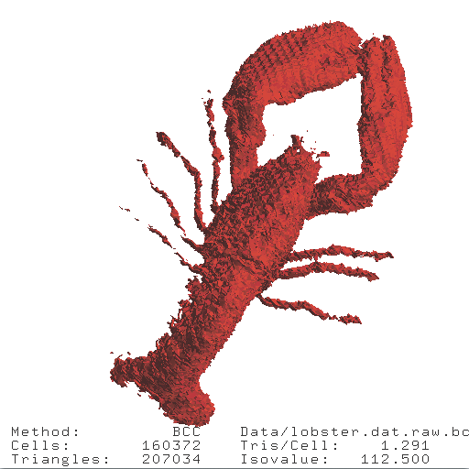
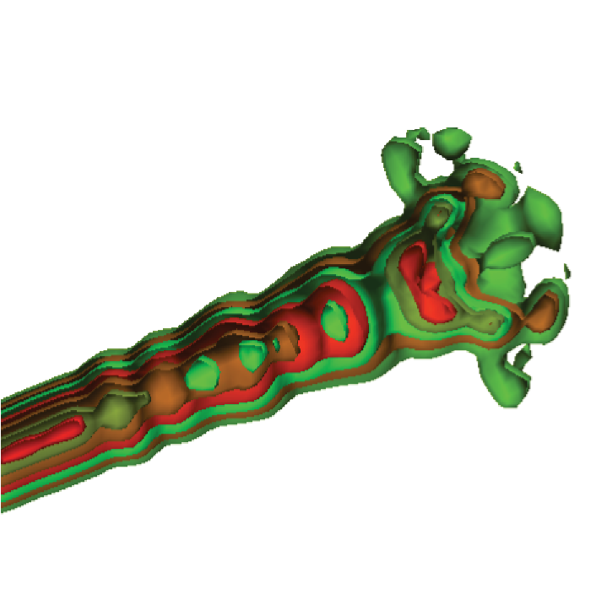
Result

Slide 14
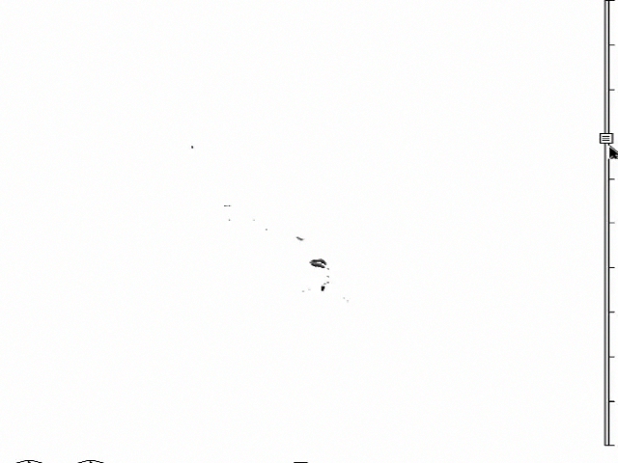
An Example

Slide 15
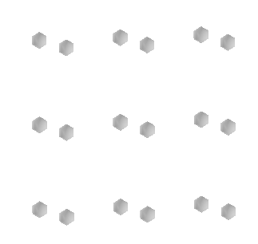
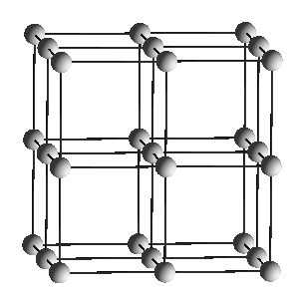
Cubic Meshes
Samples
Mesh
By far the most common case
Generalisation of squares in 2-D

Slide 16
Trilinear Interpolation
Repeat linear interpolation in 3 dimensions

Slide 17
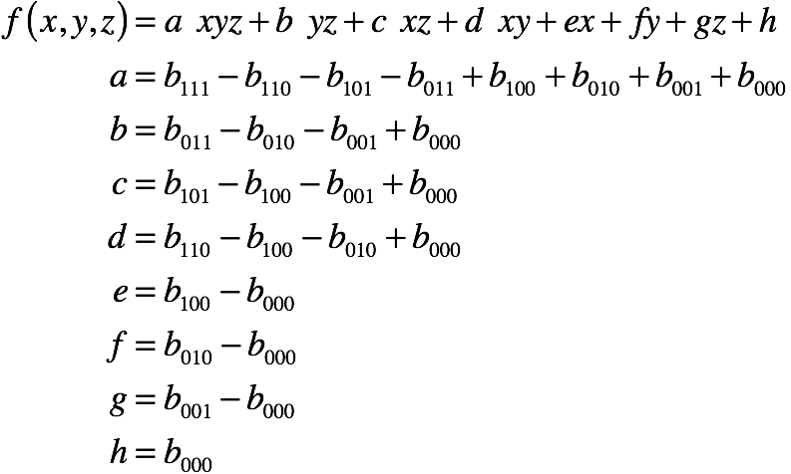
Trilinear Interpolation

Slide 18
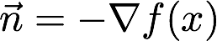
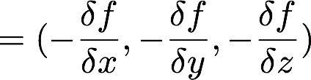
Computing Normal
Normal vector is based on gradient
always perpendicular to contours
describes steepest ascent
but outside is typically low-valued
use negative gradient as normal

Slide 19
Central Differencing:
Approximation of gradient:
Compute at vertices of cell
Interpolate along edges

Slide 20
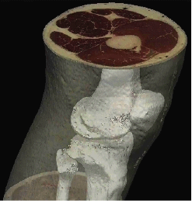
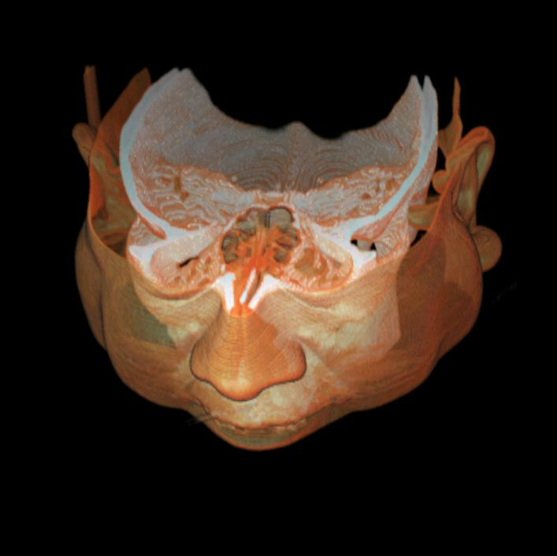
Direct Volume Rendering
Created with 3D doctor
courtesy T. Möller, SFU

Slide 21
Direct Volume Rendering
3D equivalent of colour mapping
Define a transfer function:
maps from data to colour opacity
Then compute light transport through data
i.e. a computational X-ray
Or think of it as luminous jelly

Slide 22
Modelling Transmission
No longer modelling surfaces
Modelling diffuse internal reflection
We get light added and subtracted

Slide 23

Density Clouds
Photons are blocked by absorption
Probability depends on density of material
i.e. how many particles are in the way
Measured as optical density
# of particles / mm
E.g. 5mm of lead might block 90% of photons
How much would 10mm block?

Slide 24
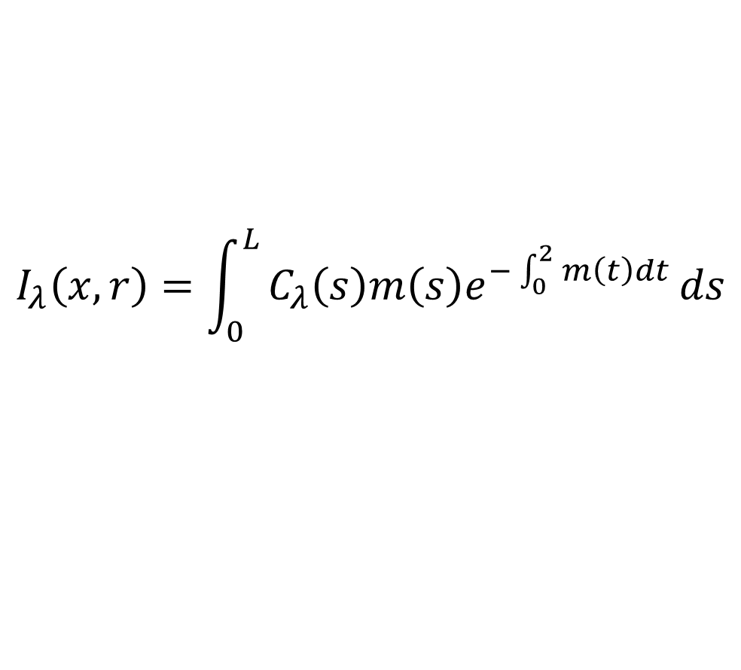
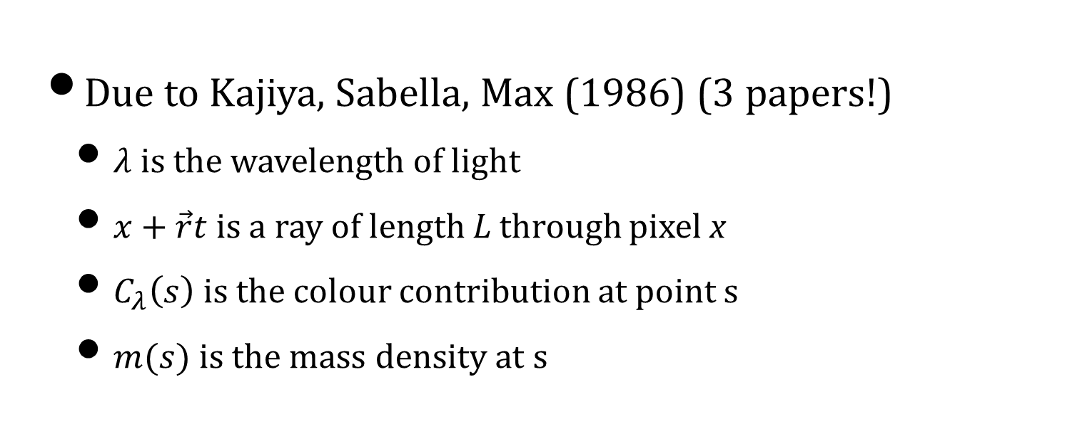
Volume Rendering Integral
$$I_{λ}\left(x,r\right)=\int_{0}^{L}{C_{λ}\left(s\right)m\left(s\right)e^{−\int_{0}^{2}{m\left(t\right)dt}}}ds$$
Due to Kajiya, Sabella, Max (1986) (3 papers!)
$λ$ is the wavelength of light
$x+\vec{r}t$ is a ray of length L through pixel x
$C_{λ}\left(s\right)$ is the colour contribution at point s
$m(s)$ is the mass density at s

Slide 25
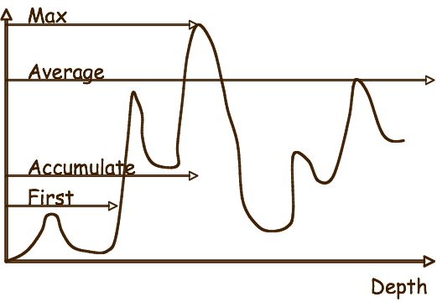
TF Design
courtesy T. Möller, SFU

Slide 26
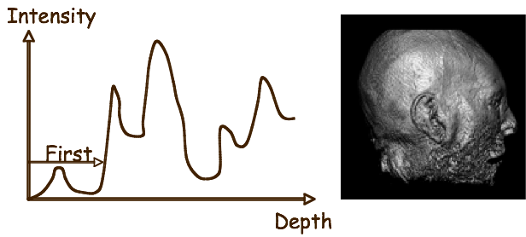
First Intersection
Equivalent to an Isosurface (Tuy&Tuy, 1984)
100% opacity at chosen isovalue
courtesy T. Möller, SFU

Slide 27
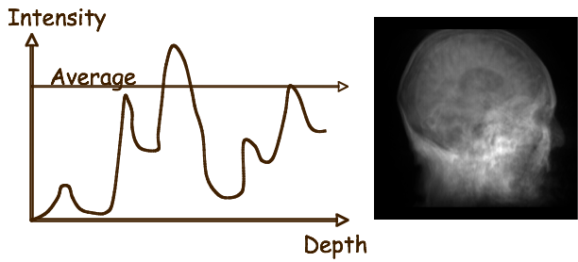
Average Intensity
Constant Opacity throughout volume
Equivalent to an x-ray
courtesy T. Möller, SFU

Slide 28
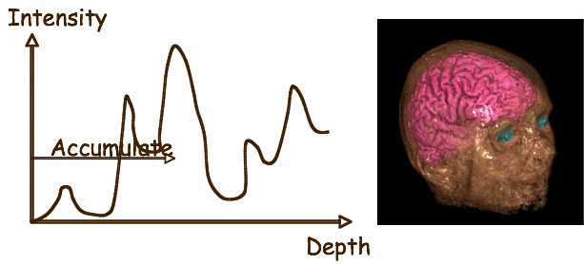
Accumulate
Use TF to highlight structures
Levoy, 1988
courtesy T. Möller, SFU

Slide 29
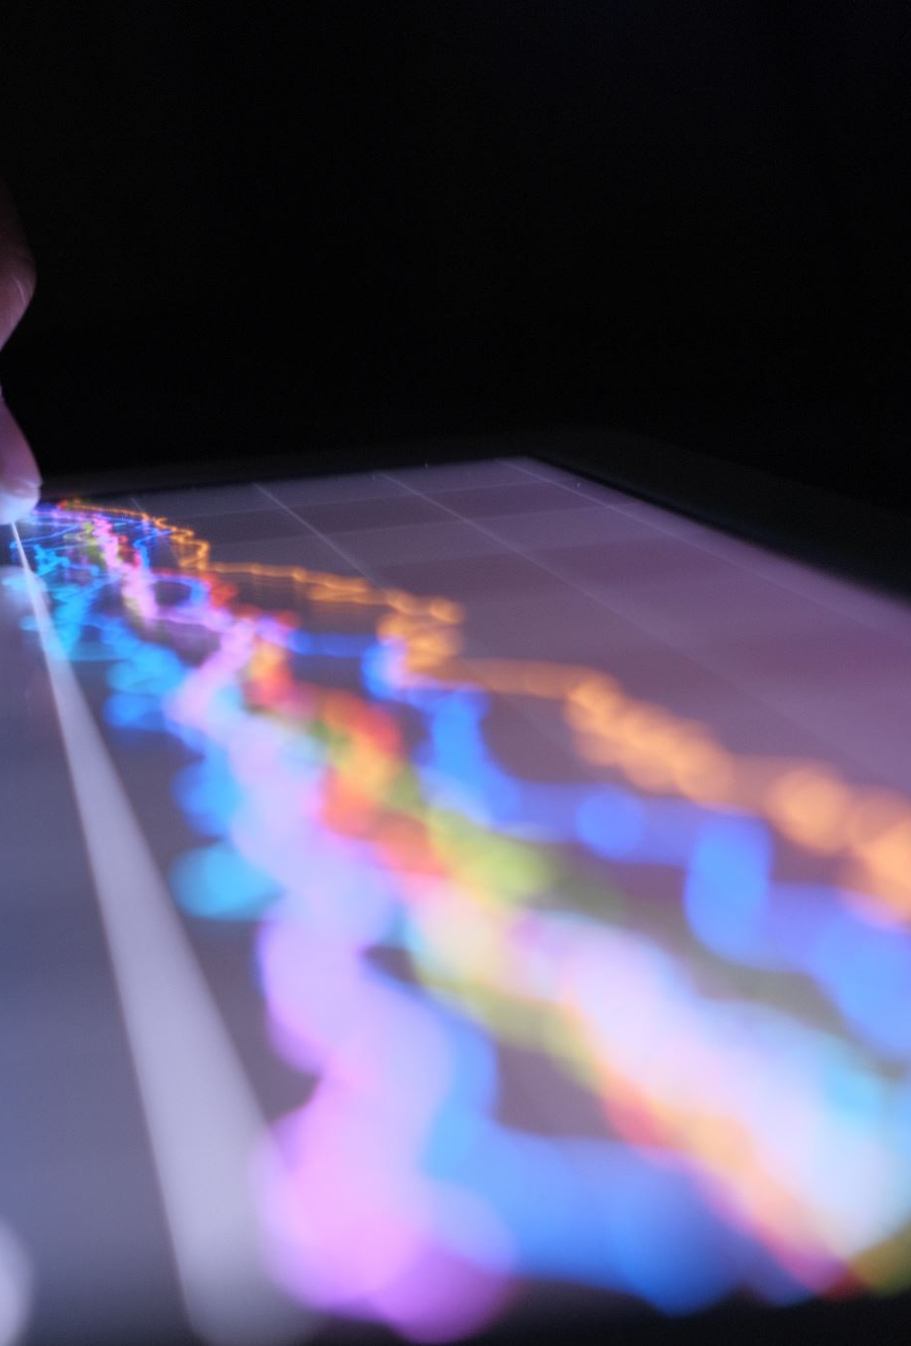
DVR Ray-tracing
For each pixel
Compute corresponding ray in volume
Walk along ray in small increments
Computing contribution to integral
Then display as image
This makes regular raytracing look cheap!
So sci. vis. has many hacks/speedups

Slide 30
Example

Slide 31
Pseudocode

Slide 32
Volume rendering algorithm
This is tracking the integration from the back forwards
If you want to have a lightsource at the side,
Modify to account for the reflection of the particles.
And for that you will need everything we talked about before, and a normal vector.
Scattering, montecarlo etc…

Slide 33
Applications to Rendering
Mist
Fog
Smoke
Explosions
Particle Systems
X-rays
Visualisation in general

